Slide 1
Richard Whitley, Director
2023-2025
Capital Improvement Projects

Slide 2
Introduction
The Department of Health and Human Services promotes the health and well-being of Nevadans through the delivery or facilitation of essential services to ensure families are strengthened, public health is protected, and individuals achieve their highest level of self-sufficiency.
Divisions:
Aging and Disability Services
Child and Family Services
Health Care Financing and Policy
Public and Behavioral Health
Welfare and Supportive Services

Slide 3
Division Descriptions
The Division of Child and Family Services (DCFS) provides children’s mental health services on the campuses of Northern Nevada Child and Adolescent Services (NNCAS) and Southern Nevada Child and Adolescent Services (SNCAS) and operates juvenile justice facilities at Nevada Youth Training Center (NYTC), Caliente Youth Center (CYC), and Summit View Youth Center (SVYC).
The Division of Public and Behavioral Health (DPBH) operates the state civil and forensic mental health hospitals (Dini-Townsend, Lakes Crossing Center, Rawson-Neal Hospital, and Stein Forensic Hospital).
The Division of Aging and Disability Services (ADSD) operates two state-owned regional centers for intellectual and/or developmental disabilities. Desert Regional Center (DRC) serves the greater Las Vegas area and Clark County with the exception of the majority of the outlying rural areas of Clark County, Sierra Regional Center (SRC) serves all of Washoe County.

Slide 4
#21146 – DCFS – SNCAS – HVAC Replacement (DWTC)
Detail Description:
This project will replace six air handling units and 91 fan coils at the Desert Willow Treatment Center (DWTC) on the Southern Nevada Child and Adolescent Services campus.
Project Justification:
Air handlers and fan coils are critical components of the facility’s HVAC system. If these components fail, then the hospital could no longer operate and serve its inpatient mental health clients. The existing air handlers and fan coils have passed their useful life. Once components have reached this age, it becomes increasingly difficult to source replacement parts. Customized or obsolete parts could take several months to replace, which could leave the hospital’s operations suspended for a prolonged period.
Background Information:
The Children’s Mental Health youth acute and residential treatment facility was built in 1998. The facility is 58,400 sq ft. The air handlers and fan coils are original to the building. The critical facility is a licensed and Joint Commission accredited 24-hour children’s psychiatric hospital.
Department Rank: #1

Slide 5
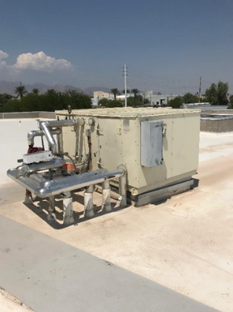
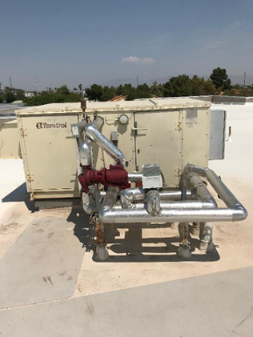
#21146 – DCFS – SNCAS – HVAC Replacement (DWTC)

Slide 6
#7442 – DPBH – SNAMHS – Anti-Ligature Rehabilitation (Rawson-Neal Hospital)
Detail Description:
This project will design and construct a rehabilitation of client restrooms at Rawson-Neal Hospital with anti-ligature lighting, anti-ligature restroom fixtures, and rehabilitate interior finishes and showers. This project will complete the replacement of affixed furniture in the client bedrooms and will replace the flooring in the client rooms, gymnasium, and allied therapy rooms.
Project Justification:
The Rawson-Neal Hospital houses both forensic and civil clients. The forensic psychiatric clients require a level of security appropriate to a detention facility and both civil and forensic psychiatric clients require a physical environment free of hazards that could cause bodily harm to themselves or others.
Background Information:
The Rawson-Neal Hospital was constructed in 2006. The interior finishes proposed for replacement are all original to the construction of the building.
Department Rank: #2

Slide 7
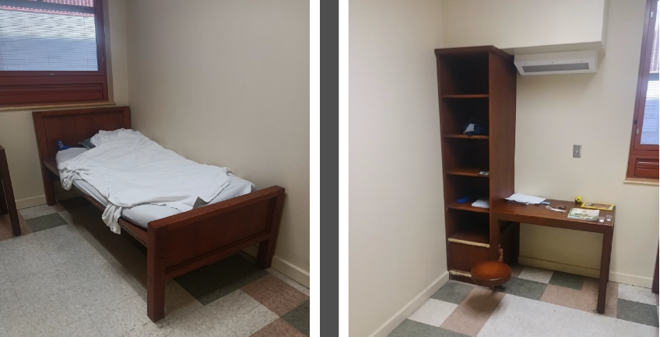
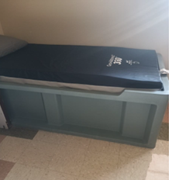
#7442 – DPBH – SNAMHS – Anti-Ligature Rehabilitation (Rawson-Neal Hospital)
Rawson-Neal Psychiatric Hospital
C-Pod Rooms (30 each)
Rawson Neal Psychiatric Hospital
Units D, E, G, H (160 each)
Compliant Anti-ligature
Affixed Bed

Slide 8
#19199 – DCFS – NNCAS – Adolescent Treatment Center Rooftop Multi-Zone Unit Replacement
Detail Description:
Replace multizone air handling unit at NNCAS Psychiatric Residential Treatment Facility (PRTF) North in Sparks.
Project Justification:
Building 8A is the residential housing unit for the PRTF North. The HVAC system for this building had a complete heating failure in FY20. DCFS released youth from the program and moved remaining youth to other locations for several months. SPWD and NNAMHS worked together to implement a temporary repair which is expected to be serviceable for a couple of years. A permanent solution is still needed to maintain a comfortable environment. In addition, SPWD has identified that the roof of this building should be replaced concurrent to this project due to water penetrating into the building during precipitation and the close connection between the roof and HVAC system. The roof has also received temporary repairs.
Background Information:
Building 8A is 5,237 sq. ft. and was constructed in 1977.
Department Rank: #3

Slide 9
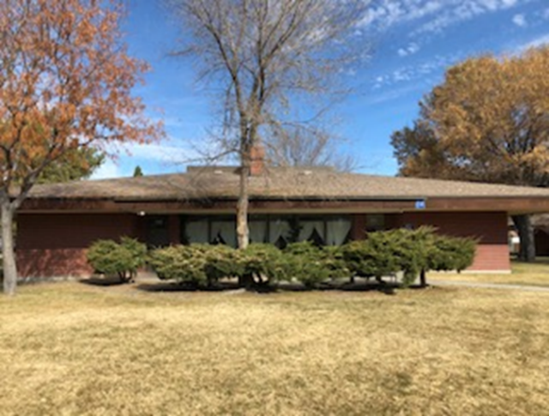
#19199 – DCFS – NNCAS – Adolescent Treatment Center Rooftop Multi-Zone Unit Replacement

Slide 10
#7438 – DPBH – SNAMHS – Anti-Ligature Rehabilitation (Stein Forensic Hospital)
Detail Description:
This project will design and construct a rehabilitation of client restrooms with anti-ligature lighting and restroom fixtures and rehabilitate interior finishes and showers, including replacing the affixed furniture in the client bedrooms. This project will also replace doors and repair exterior finishes around the building at grade level.
Project Justification:
The Stein Forensic Hospital treats forensic clients who require a level of security appropriate to a detention facility. Clients in this facility can be placed on suicide watch at any time and thus is necessary that the client areas be improved with tamper resistant and anti-ligature fixtures and affixed furniture to prevent personal injury. The facility has doors that are not conducive for a forensic hospital.
Background Information:
Stein Forensic Hospital (Building 3) was originally constructed in 1988. Stein Hospital was remodeled to a forensic hospital (CIP project 13-C08). However, the remodel did not include door replacement in the project scope. This project was previously requested in 2017, 2019, and 2021. The partial construction documents for the door replacement and the exterior repairs were completed in 2022, under Project 22-A010.
Department Rank: #4

Slide 11
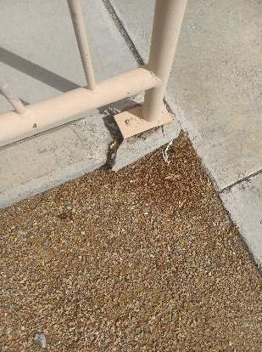
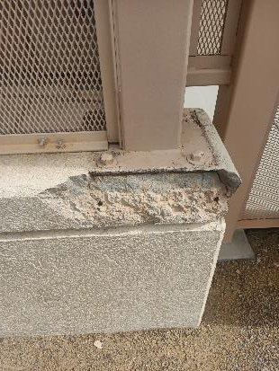
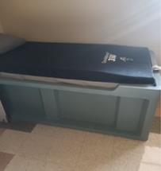
#7438 – DPBH – SNAMHS – Anti-Ligature Rehabilitation (Stein Forensic Hospital)
Compliant
Anti-ligature
Affixed Bed

Slide 12
#23195 – DPBH – Lakes Crossing Center – Secured Area Door Replacement
Detail Description:
This project will design and construct detention grade doors to replace security access controlled, solitary, and client room doors/hardware/hinges. Secondary secured area doors will be replaced including anti-ligature hardware/hinges.
Project Justification:
The doors are in a state of disrepair to the point in which a human could use force to break a door using physical strength. Due to the age and design of the older doors there is a significant ligature risk, and therefore this project is critical for the safety of clients.
Background Information:
Lakes Crossing Center was built in 1974. The doors have been repaired numerous times due to client damage. Removing and rehanging the doors to repair is a safety issue. Many of the doors are compromised from the repetitive damage and repairs.
Department Rank: #5

Slide 13
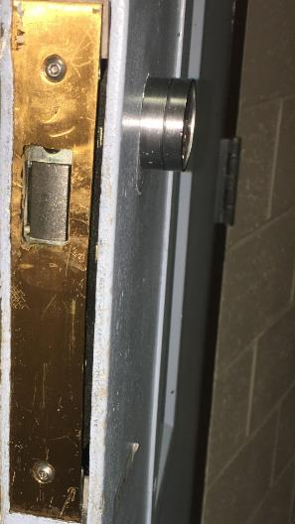
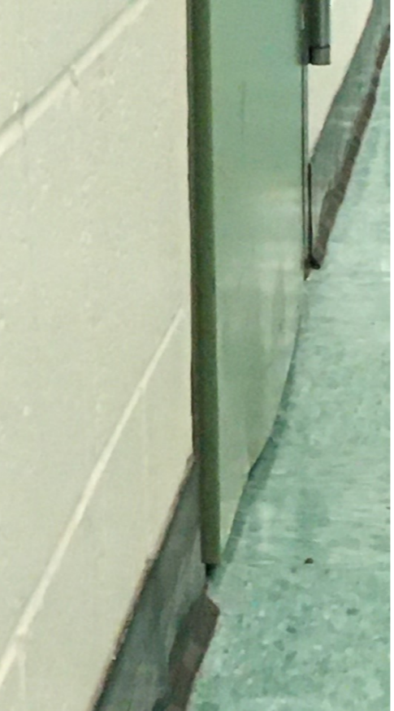
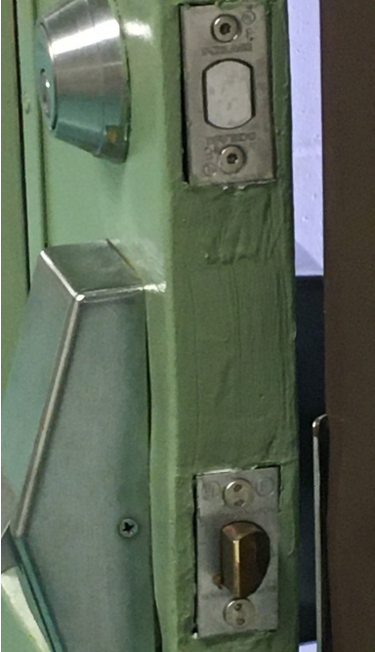
#23195 – DPBH – Lakes Crossing Center – Secured Area Door Replacement
Deformed Steel Door
Compromised Door Stiles

Slide 14
#23196 – DPBH – Lakes Crossing Center – Replace Video Surveillance System
Detail Description:
This project will design and construct an augmentation to existing security cameras, security monitoring equipment, viewing stations, and data storage at the Lakes Crossing Center. This project will also provide a separate viewing station for high-risk clients.
Project Justification:
The existing camera system has poor resolution where needed, limited coverage in areas of the facility, and can only store recorded video for approximately 24 hours before being overwritten. This equipment will record and document actual activities and reduce gaps in camera coverage to protect staff and patients and document events for incident reporting.
Background Information:
The Lakes Crossing Center Building #13 is 35,804 square-feet and was constructed in 1974.
Department Rank: #6

Slide 15
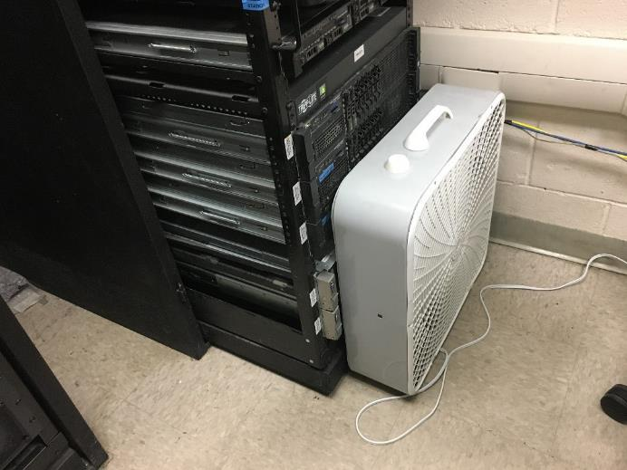
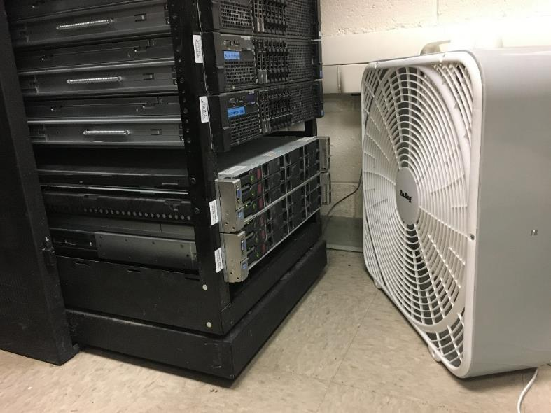
#23196 – DPBH – Lakes Crossing Center – Replace Video Surveillance System
Recording, Storage, and Cooling Equipment

Slide 16
#7678 – DPBH – SNAMHS – Advance Planning: Southern Nevada Forensic Facility
Detail Description:
This project will provide advance planning through schematic design documents for a facility to serve individuals awaiting adjudication pending treatment to competency. This facility will accommodate approximately 282 beds to meet the anticipated need for the next fifteen years. The facility will be located at the Southern Nevada Adult Mental Health Campus on West Charleston in Las Vegas.
Project Justification:
Lakes Crossing Center, Stein Forensic Hospital, and a portion of the Rawson-Neal Hospital provide services for evaluation and/or treatment for restoration to legal competency. The average length of stay for clients is approximately 105 days, but AB193 and SB380 (passed in the 73rd legislative session) mandate that long-term incompetent clients can be committed to the agency for over ten years. As more long-term clients are committed, there is a shortage of beds available for the short-term pre-trial commitments. Current facilities will be at maximum capacity in 2022. In 2015, the average monthly census was 80, by 2022 it rose to 163. DPBH added capacity by utilizing civil beds in Rawson-Neal Hospital, which were not designed to provide services for this population.
Background Information:
This project has been previously requested in 2017, 2019, and 2021.
Department Rank: #7

Slide 17
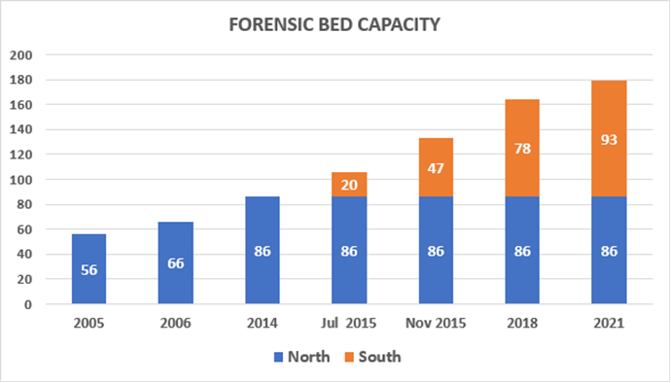
#7678 – DPBH – SNAMHS – Advance Planning: Southern Nevada Forensic Facility

Slide 18
#23197 – DCFS – SVYC – Replace Emergency Generator
Detail Description:
This project will replace the existing generator and transfer switch at Summit View Youth Center.
Project Justification:
The current generator is not capable of adequately powering the buildings on this site during emergency power outages and does not comply with the State of Nevada Disaster plan, which calls for the generator to run all essential systems for 3 days in the event of a disaster. During a power outage, the current generator will only power the emergency lighting in the facility. Safety and security systems are not supported, causing potential life safety issues and increasing risk to the youth, staff and the community. During long power outages, the kitchen is not operational, which causes issues for staff and personnel. The replacement generator will be large enough to provide emergency power to the entire site.
Background Information:
The facility was constructed in 2000 and sits on 13 acres. The existing generator is original to the facility, with a manufacture date of 1999, making it 22+ years old and past its useful life. It is obsolete and undersized for intended purpose.
Department Rank: #8

Slide 19
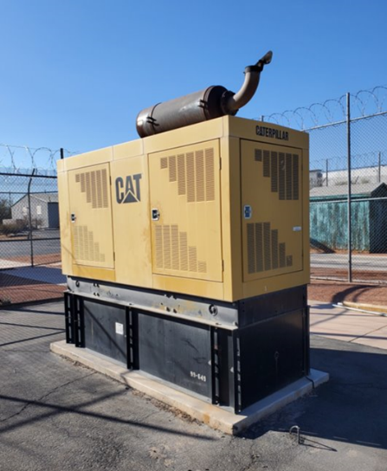
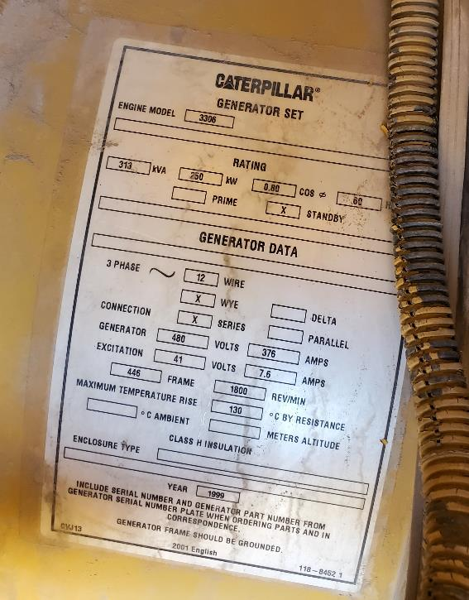
#23197 – DCFS – SVYC – Replace Emergency Generator

Slide 20
#23198 – DPBH – Lakes Crossing Center – Shower Room Renovation
Detail Description:
This project will design and construct the renovation of 5 shower stalls in the Lakes Crossing Center housing units.
Project Justification:
The existing shower stalls are showing signs of failure. Plumbing leaks within the shower walls cause ceramic tile to loosen posing safety issues to clients. Mold could develop and potentially cause a health risk. Three other shower stalls were remodeled in 2016.
Background Information:
The Lakes Crossing Center is 35,804 square-feet and was constructed in 1974.
Department Rank: #9

Slide 21
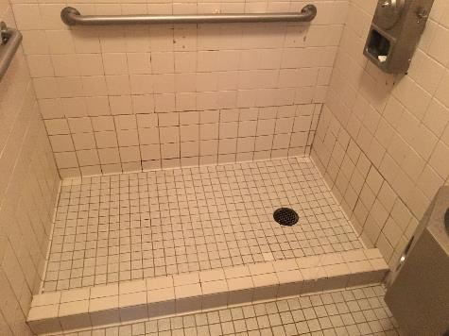
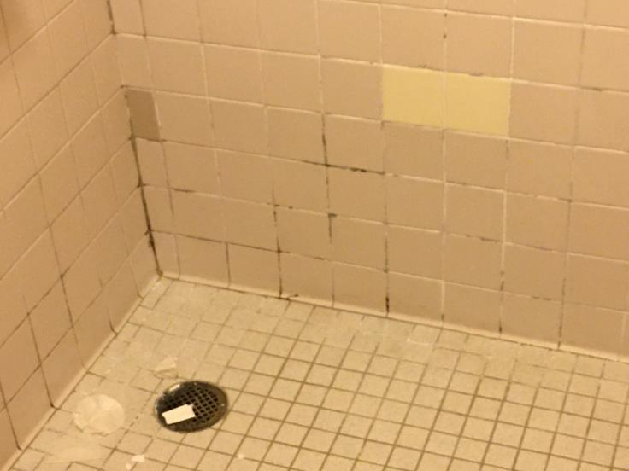
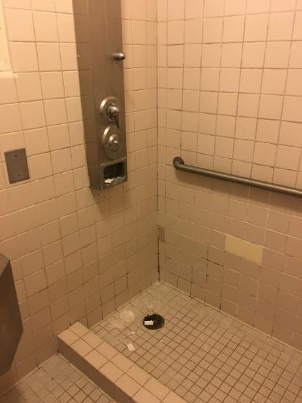
#23198 – DPBH – Lakes Crossing Center – Shower Room Renovation
Aging Shower Room

Slide 22
#23199 – DPBH – SNAMHS – Elevator Replacement (Stein Forensic Hospital)
Detail Description:
This project will design and construct the rehabilitation of the passenger and freight elevators at the Stein Forensic Hospital.
Project Justification:
The elevators are original to the building and are beyond their useful service life. When these elevators malfunction, occupants are trapped inside the elevator cabs. Due to the age of the equipment, repairs have become increasingly common, and it has become difficult to obtain replacement parts. If this project is not approved, repair costs will continue to increase and elevator closures will impact operations, affecting the transport of food and supplies.
Background Information:
Stein Forensic Hospital (Building 3) was originally constructed in 1988 as a psychiatric hospital. Stein Forensic Hospital was unoccupied between 2009 and 2016 when the building was remodeled to a forensic psychiatric hospital (CIP project 13-C08), however, that remodel did not include elevator rehabilitation in the project scope. Design development drawings were completed by the agency in 2022, under Project 22-A013.
Department Rank: #10

Slide 23
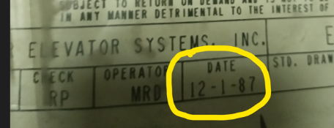
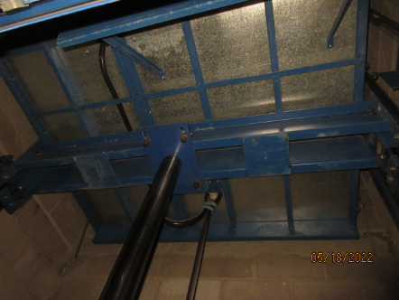
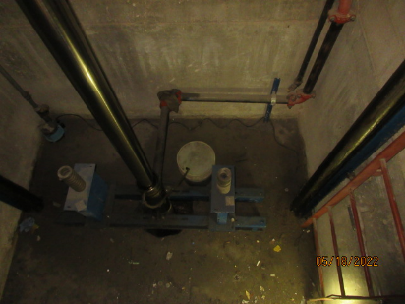
#23199 – DPBH – SNAMHS – Elevator Replacement (Stein Forensic Hospital)

Slide 24
#21151 – DCFS – SNCAS – Interior Remodel and Window Replacement (Buildings 11 & 12)
Detail Description:
This project will design and construct a remodeling of the bathrooms and kitchens of Buildings 11 and 12 at the Southern Nevada Child and Adolescent Services campus to create accessible bathrooms and kitchens at the first floor, install solid surface seamless showers, replace wall and floor finishes, repair under floor plumbing, and replace plumbing fixtures. This project will also replace windows in Buildings 11 and 12 at the Southern Nevada Child and Adolescent Services campus. The replacements will include dual pane, low-e, impact resistant glass. The frames will be painted to complement the existing buildings. This project will also include an evaluation and cost analysis of window replacement alternatives for each building.
Project Justification:
The existing bathroom materials are not seamless, and youth have been breaking off pieces for contraband, which could be used to harm themselves or other patients and staff. The installation of anti-ligature fixtures and bathroom accessories will minimize opportunities for self-harm. Buildings 11 and 12 do not have accessible bathrooms, limiting the youth who can be served at these facilities. The existing kitchens and millwork are at the end of their useful service life and need to be replaced to meet code and ADA accessibility requirements. The existing windows are not impact resistant. When the windows are broken, pieces can be used by the youth to harm themselves, other youth, or staff. In May 2020, the facility experienced four broken windows and two elopements. After a window breakage the room is boarded up and considered unusable until the repair is completed, limiting the facility's capacity to provide mental health services. The double pane, low-e glazing will increase resident comfort by reducing drafts and increase energy efficiency, which supports the intent of Senate Bill 254 of the 2019 Legislative Session.
Background Information:
Buildings 11 and 12 were built in 1981 and are being used as part of the Oasis Residential Treatment Center.
Department Rank: #11

Slide 25
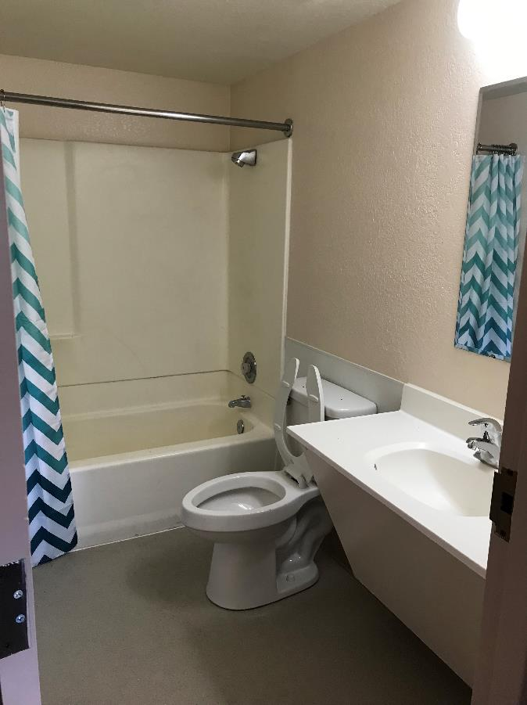
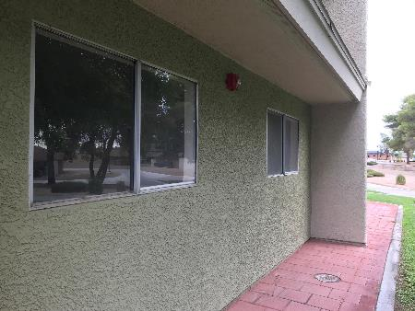
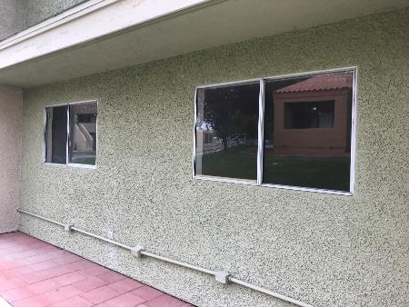
#21151 – DCFS – SNCAS – Interior Remodel and Window Replacement (Buildings 11 & 12)

Slide 26
#23204 – DCFS – SVYC – Gymnasium Addition and Remodel
Detail Description:
This project will design and construct additional multi-purpose rooms, add a restroom, athletic flooring, an air conditioning system, a closed-circuit TV system, insulation to the walls and roof assemblies and replace the lighting and bleachers in the Gymnasium at Summit View Youth Center (SVYC).
Project Justification:
The SVYC facility does not have flexible rooms for use by the youths. The addition of multipurpose rooms will provide indoor recreational opportunities. The project will also add a closed-circuit TV system for the safety and security of the users. The evaporative coolers are original to construction and have reached the end of their useful service life. The extreme Las Vegas temperatures do not allow the youth to participate in the gym safely. Adding a new air conditioning system will provide the necessary heating and cooling to increase participation. The existing bleachers are original to the building and need to be replaced. If this project is not funded, the gymnasium will continue to be underutilized and the youth will be underserved in opportunities for rest and physical exercise.
Background Information:
The gymnasium at SVYC was built in 2000.
Department Rank: #12

Slide 27
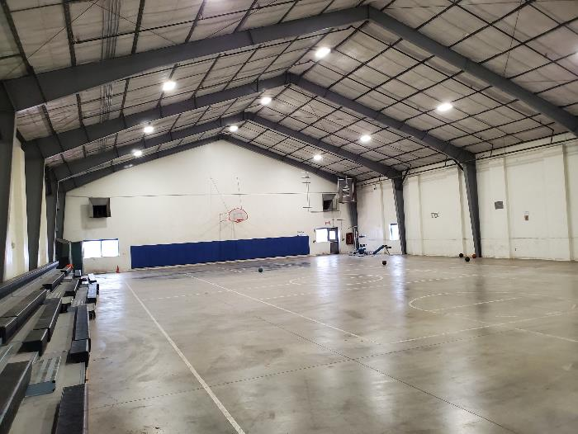
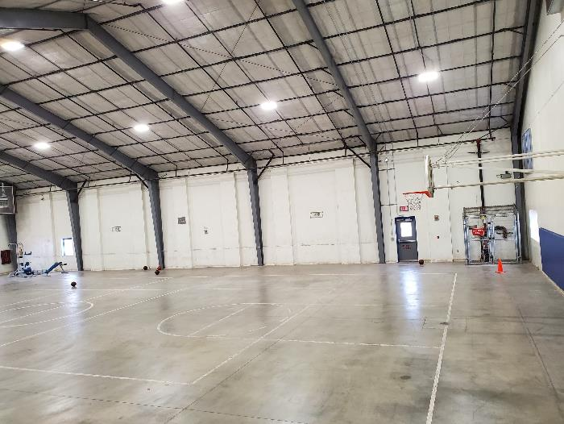
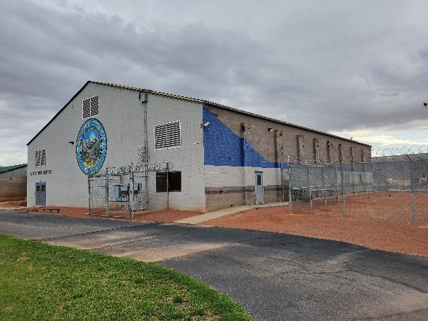
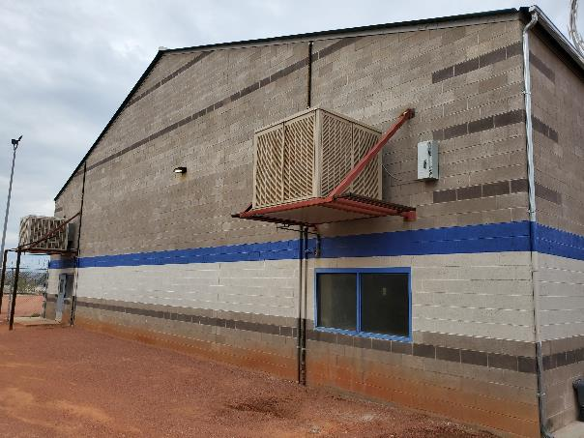
#23204 – DCFS – SVYC – Gymnasium Addition and Remodel

Slide 28
#7508 – DCFS – NYTC – Gymnasium Floor Replacement
Detail Description:
This project is to design and construct removal and replacement of the existing athletic flooring at the Nevada Youth Training Center (NYTC). The project will install traditional athletic wood flooring.
Project Justification:
The current vinyl floor is deteriorating through high use and is showing signs of failure. The flooring needs to be replaced to eliminate tripping hazards and possible injury to youth, staff and visitors during sporting events.
Background Information:
The Nevada Youth Training Center is located on the east side of Elko Nevada. The site dates to the early 1900s and serves as a school and facility for juvenile offenders. The Gymnasium was built in 1976 and is a brick masonry and steel framed structure. It contains a large gymnasium area, restrooms, lockers, storage rooms and a mechanical room.
Department Rank: #13

Slide 29
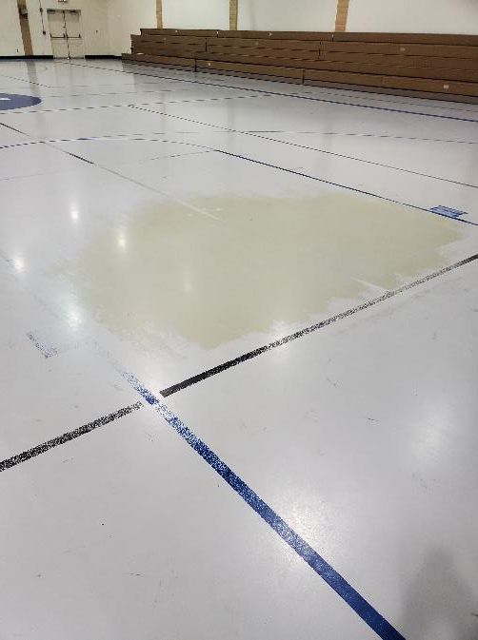
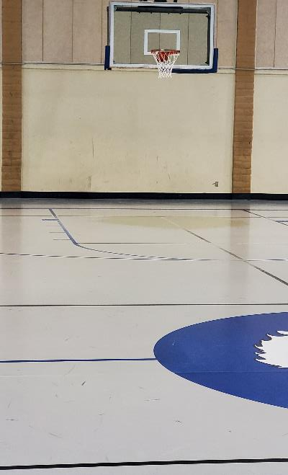
#7508 – DCFS – NYTC – Gymnasium Floor Replacement

Slide 30
#7515 – DCFS – NYTC – Classroom/Infirmary Building Flooring Replacement
Detail Description:
This project will design and construct replacement of the flooring in the Classroom/ Infirmary building at the Nevada Youth Training Center (NYTC). This project will include heavy duty vinyl tile, carpet and ceramic tile as well as cove base.
Project Justification:
Due to the age and heavy foot traffic, the materials are worn out. The public, youth and staff which utilize this building are at risk of tripping on a broken tile or torn piece of carpet. The floor tiles, carpet, etc. have far surpassed their useful life. The materials are at the point of not being able to be maintained or repaired.
Background Information:
The Nevada Youth Training Center is located on the east side of Elko Nevada. The site dates to the early 1900s and serves as a school and facility for juvenile offenders. The Classroom/Infirmary Building was originally constructed in 1972. The ceramic tile and VCT tile flooring is original.
Department Rank: #14

Slide 31
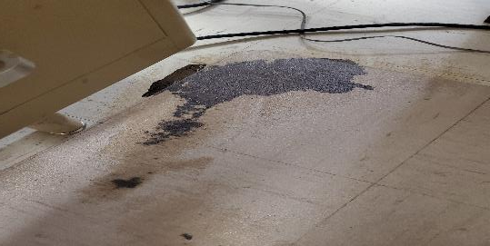
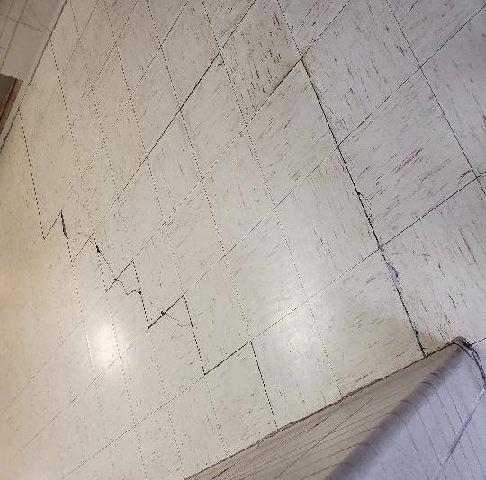
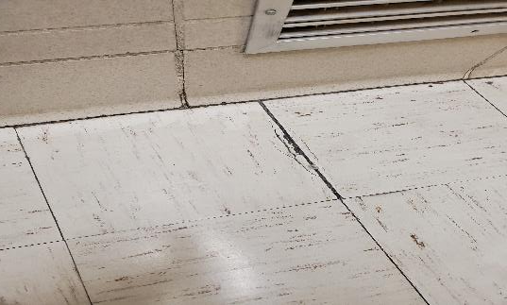
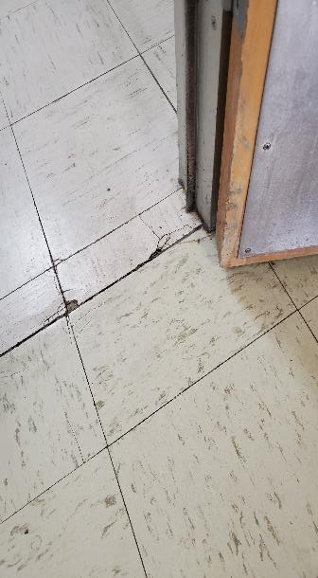
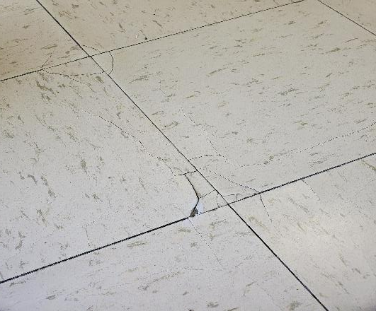
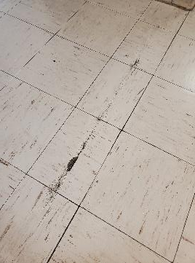
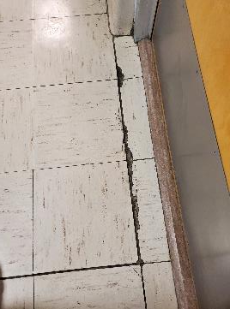
#7515 – DCFS – NYTC – Classroom/Infirmary Building Flooring Replacement

Slide 32
#19235 – DCFS – NYTC – Connect Well #2 to the Irrigation System
Detail Description:
This project will design and construct upgrades to water infrastructure at the Nevada Youth Training Center (NYTC) necessary to connect the existing Well #2 to the irrigation system. Maintenance of Well #1 is included in this project because it will remain the sole domestic water source at NYTC. The project scope includes rehabilitation of Wells #1 and #2, replacement pumps at each well, instrumentation reconfiguration, installation of a backflow preventer at the gym, and site piping necessary to connect Well #2 to the existing irrigation system.
Project Justification:
Well #1 is the sole domestic water and irrigation source at NYTC as Well #2 cannot be connected to the water system. This arrangement, although workable, results in a high usage of Well #1. Connecting Well #2 to the irrigation system will relieve Well #1 from that duty and prolong its useful life. Connecting Well #2 to the irrigation system also provides the ability to use existing water rights at NYTC that otherwise could be forfeited as they are not currently utilized.
Background Information:
The Nevada Youth Training Center domestic water system is over 50 years old. The majority of buildings and infrastructure were constructed in the 1960‘s & 1970’s. Potable and irrigation water to the NYTC campus is provided by a single well and a 400,000-gallon water storage tank located just west of the campus. A second well was constructed with a previous CIP project (09-M08), however the yield from this well has an extremely high ferrous content making it unsuitable for domestic use.
Department Rank: #15

Slide 33
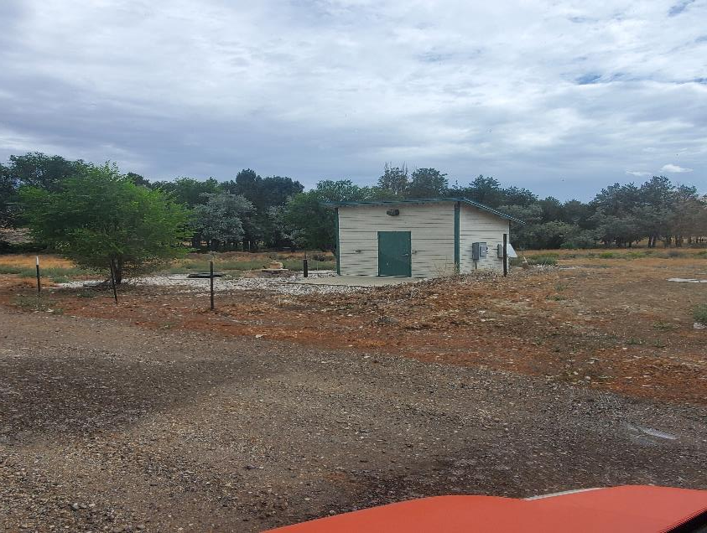
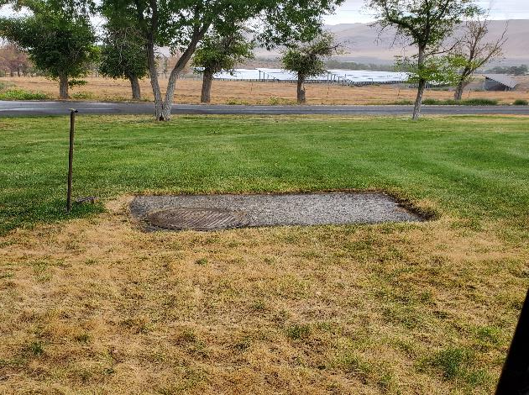
#19235 – DCFS – NYTC – Connect Well #2 to the Irrigation System

Slide 34
#7511 – DCFS – NYTC – Upgrade Irrigation System
Detail Description:
The project will design and construct a campus-wide replacement of the irrigation water systems at the Nevada Youth Training Center (NYTC). The sports field irrigation system is in good condition and will not be included with this project. The project scope includes abandonment of the existing irrigation facilities, installation of new irrigation mains, valves, sprinkler heads, and control wiring. If possible, recently upgraded sprinkler heads will be reused.
Project Justification:
The existing irrigation system was installed in 1974 and has far exceeded its useful life. Current pipe materials are inconsistent with current standards resulting in continual maintenance and failures. The site use has changed over the years and the existing sprinkler layout is wasteful and inefficient.
Background Information:
The Nevada Youth Training Center operates its own domestic water system which is over 50 years old. The majority of buildings and infrastructure were constructed in the 1960‘s and 1970’s.
Department Rank: #16

Slide 35
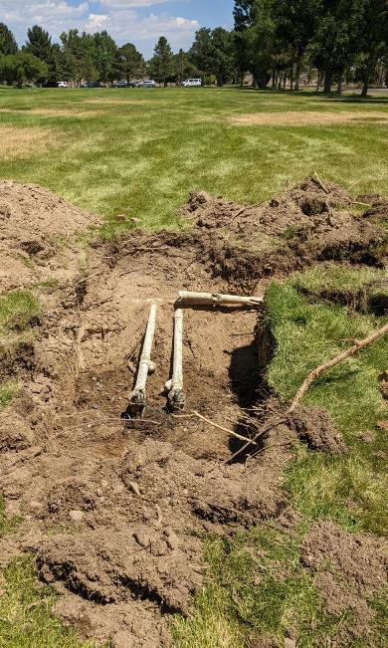
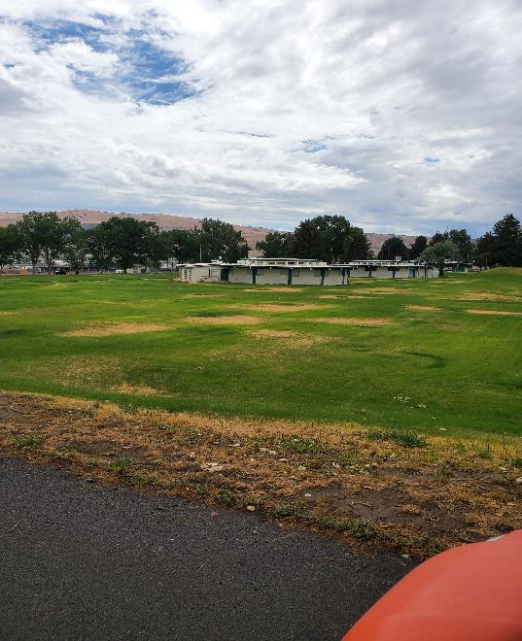
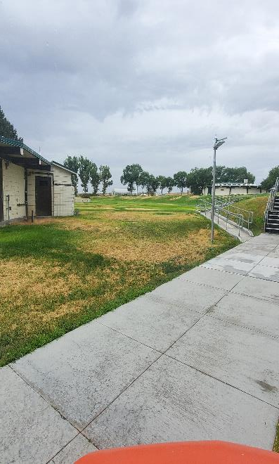
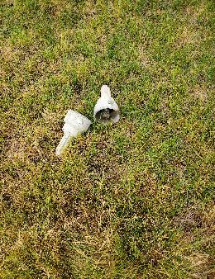
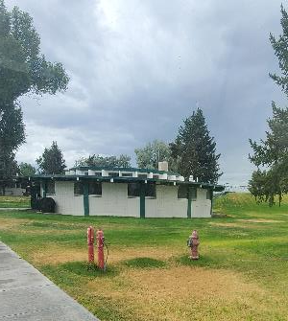
#7511 – DCFS – NYTC – Upgrade Irrigation System

Slide 36
#19194 – DCFS – SNCAS – Patio Wall Caps (DWTC)
Detail Description:
This project will design and construct a rounded wall cap on top of the patio yard walls at Desert Willow Treatment Center at the Southern Nevada Child and Adolescent Services campus.
Project Justification:
At ten feet high, the patio walls can be breached by the residents in care. The new rounded wall caps will discourage elopement by hindering the residents' ability to obtain a firm grip at the top of the walls.
Background Information:
This facility was constructed in 1998 with 5 patient units. This project was previously requested in 2019 and 2021.
Department Rank: #17

Slide 37
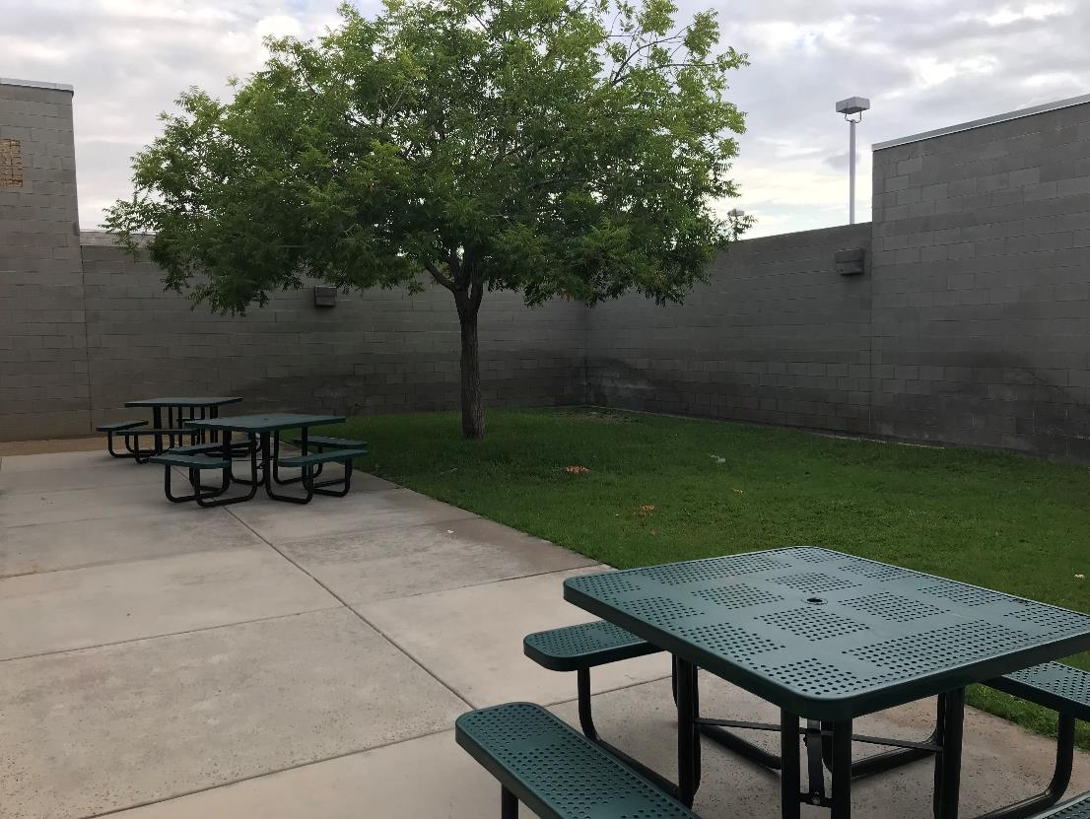
#19194 – DCFS – SNCAS – Patio Wall Caps (DWTC)

Slide 38
#21153 – DCFS – SNCAS – Install Security Cameras
Detail Description:
This project will design and construct a surveillance system including fixed cameras and digital storage to retain images for future use at Southern Nevada Child and Adolescent Services.
Project Justification:
There have been campus buildings and vehicles broken into and vandalized. Camera footage will assist with criminal investigations and better document employee and client incidents (i.e., runaways, outdoor fights, etc.).
Background Information:
The site occupies 8 acres and was constructed in 1974.
Department Rank: #18

Slide 39
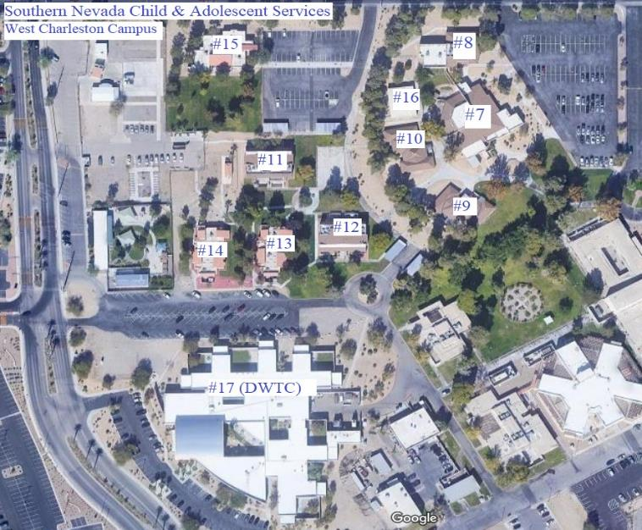
#21153 – DCFS – SNCAS – Install Security Cameras

Slide 40
#21126 – ADSD – DRC – Security Fencing
Detail Description:
The project will design and construct perimeter security fencing at the Desert Regional Center (DRC) campus. The security fencing will include access-controlled pedestrian gates and electrically operated vehicle gates for regular vehicle and emergency vehicle access. This project is located on State property.
Project Justification:
DRC’s Intermediate Care Facility (ICF) provides residential supports to persons with intellectual and developmental disabilities. Currently, the ICF doors are locked from the inside and most individuals require a staff member to open the exterior doors for them and escort them outside. This arrangement does not allow for individual privacy. Several of the individuals also lack safety awareness and can easily wander off the ICF Campus on to the busy streets of Jones or Charleston risking serious injury. Other individuals may run onto these roads to elope or purposely harm themselves when upset. Due to its location, the ICF campus experiences a lot of unauthorized foot traffic. Homeless individuals have attempted to set up encampments on the ICF campus. In the last five years there have been break-ins in two of the administrative buildings as well as employee vehicles. Most recently, a bicycle was stolen from a backyard. Having the ICF fencing project completed will improve the quality of life of the persons served. It will allow a majority of the residents to exit their homes and walk the ICF community without staff nearby, allowing staff to monitor from a distance. The defined boundary will give the individuals served freedom and independence. Also, the security fencing will help to make the environment safer by reducing unauthorized cross campus traffic, theft, and vandalism.
Background Information:
The DRC was built in 1976. The security fence was requested in 2019 and 2021. The schematic design for this project was completed by the agency in 2021, under Project 21-A021.
Department Rank: #19

Slide 41
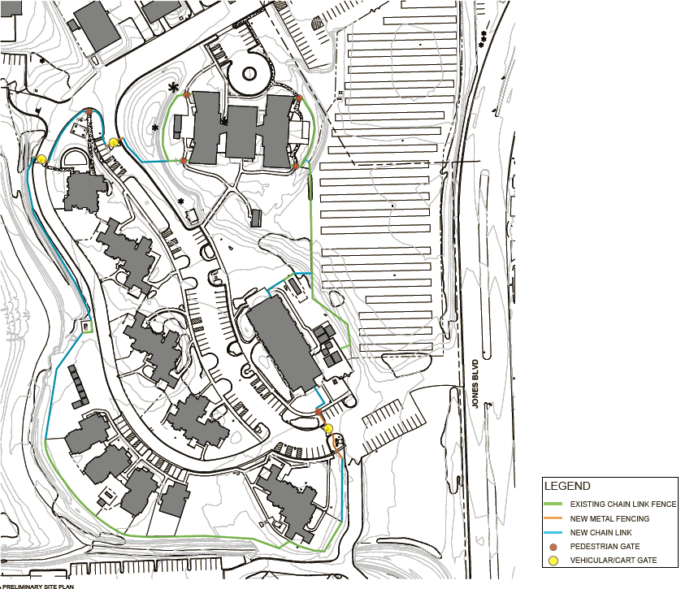
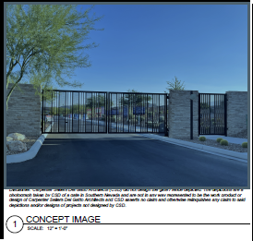
#21126 – ADSD – DRC – Security Fencing

Slide 42
#21141 – DCFS – NYTC – Security Entrance Gates
Detail Description:
This project will design and construct electronic security gates with a key card access at the two entrances to the Nevada Youth Training Center (NYTC) facility including site improvements and utility connections.
Project Justification:
The Nevada Youth Training Center is a facility which houses troubled youth in a structured rehabilitation program. The facility does not have a fence or a secure point of access, and there is currently no way to control vehicular access to the facility. These gates would allow for the Nevada Division of Forestry, which is housed at the northeast corner of the property, to still have access to their facility, it would allow for visitors to access the Administration Building for check-in purposes, but it would not allow unauthorized access to the back of the campus.
Background Information:
The Nevada Youth Training Center was constructed in multiple phases which started in 1962 with the last structures having been completed in the mid 1990's.
Department Rank: #20

Slide 43
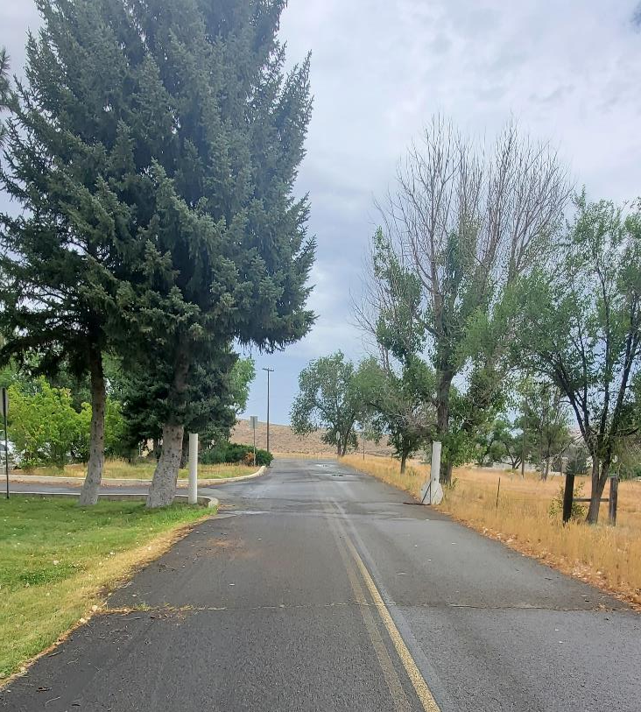
#21141 – DCFS – NYTC – Security Entrance Gates

Slide 44
Questions?

